Slide 1

Hooah Housing
Brian Kropf
Jessica Yescas
Daniel Nam
Betsy Rosales
Angela Lee
Notes:
*Name for app can always change, if someone has better idea please let us know lol (to be more general to all vets)

Slide 2
What is the issue we are solving?
What do we help them with?
Social Isolation: Student veteran's isolation in academic settings
Customer group: Recently discharged student veterans

Slide 3

How might we support recently discharged veterans to successfully engage in school and minimize social isolation?

Slide 4
Hooah Housing will..
Make connection between student veterans in order to:
Create social network
Assist in transition to civilian (educational) environment
Initiate opportunity to find better housing

Slide 5
Features of Hooah
Connect with other student veterans in the nearby area to live with
Choose from a variety of people to reside with based on their profiles
Chat function to get to know each other better
List resources student veterans can go to for help
To be added: List of housings for veterans
*We hope veterans can share information and help each other out as well

Slide 6

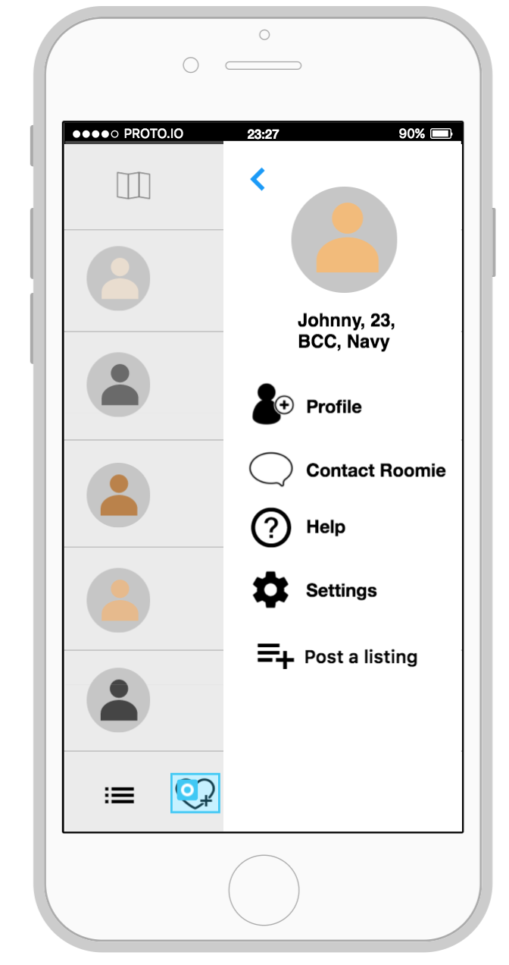
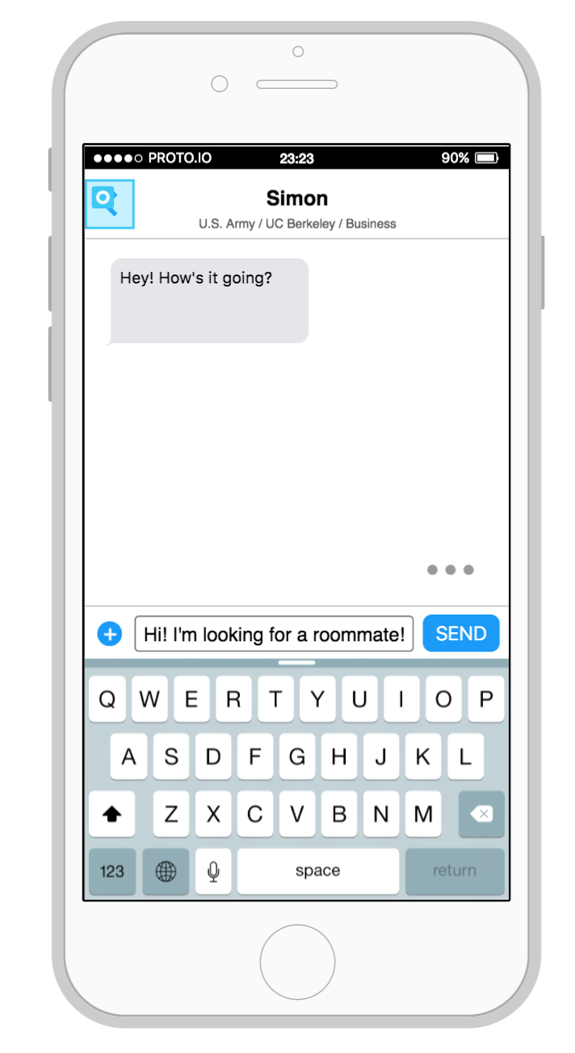

Slide 7
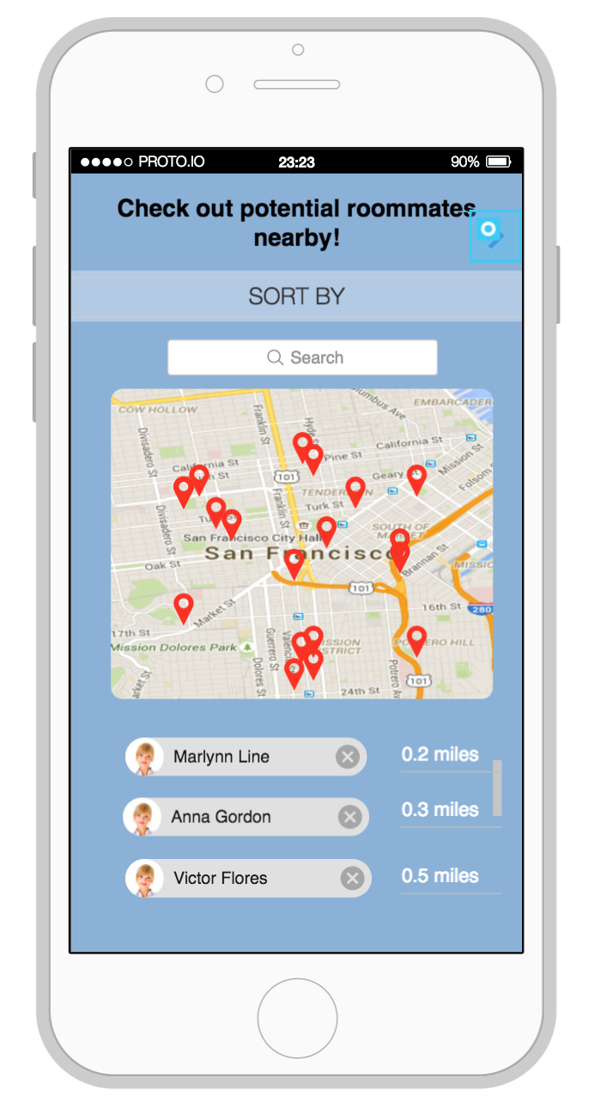
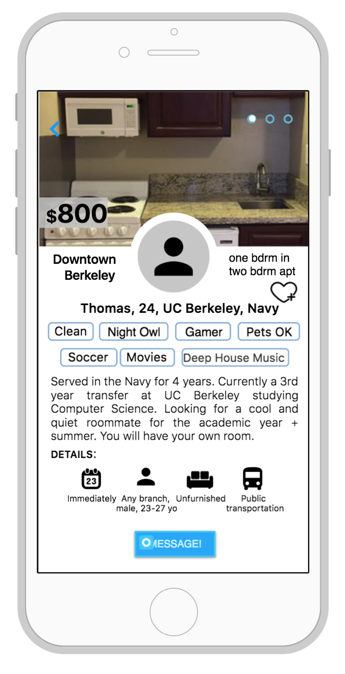
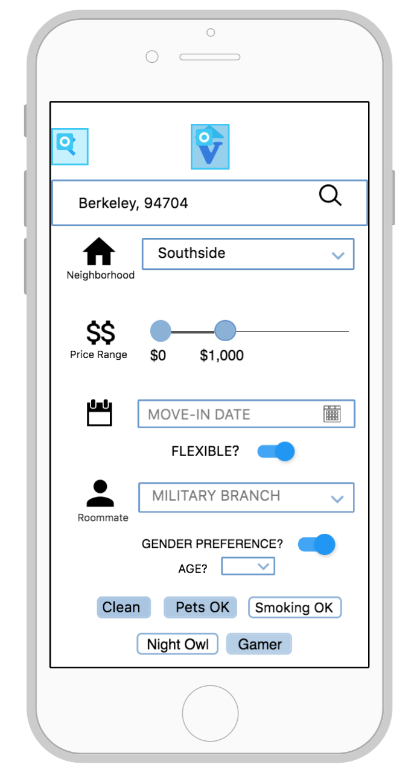

Slide 8
What makes Hooah Housing important?
School might be first place where a veteran learns to transition back into non-military life
Age & background difference could amplify isolation
Not all student veterans know each other
Overcoming isolation in school can be beneficial to preventing other isolations

Slide 9
What student veterans think about Hooah...
“Could be helpful to those who are looking for roommates...”
“Not too interested with living with other veterans, but would be interested if cheaper housing...”
“It is really helpful to be able to live with someone who understands where you’re coming from…”
"It could promote other veterans to pursue higher education..."
“ The age difference makes it difficult [to live with] sometimes…”
Notes:
*These quotes present both pros and cons, so maybe make separate slides, or only make them positive

